Slide 1
Finding the next
TikTok
hit song
Alex Kim, Bolun Zhang, Davis Gill, Ruby Nie

Slide 2
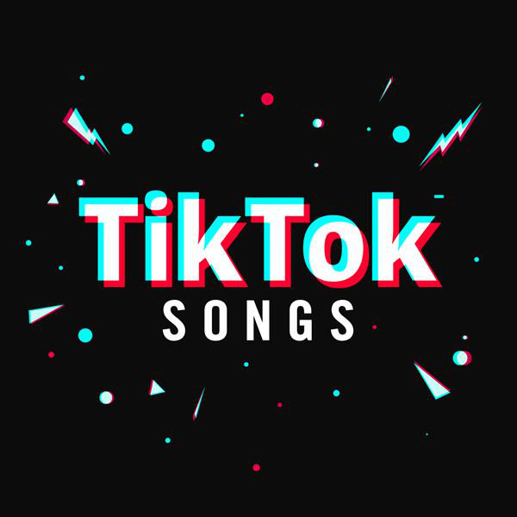
The importance of song choice
Conveyance: in a hyper-competitive space like TikTok where creators have seconds (or less) to capture attention and avoid being scrolled past, every aspect is critical. The perfect song choice compliments the video/text and can add additional mood or personality.
Community: TikToks sharing the same song usage can easily be found. Using a popular song instantly makes you part of that community and increase chances of becoming viral.

Slide 3
Objective
Using the lyrics from previous popular songs on TikTok, can we predict what new releases will end up as TikTok hits?

Slide 4


Data Source
Spotify playlists of top TikTok hits in 2022 and 2023
Matching lyrics from Genius Database

Slide 5
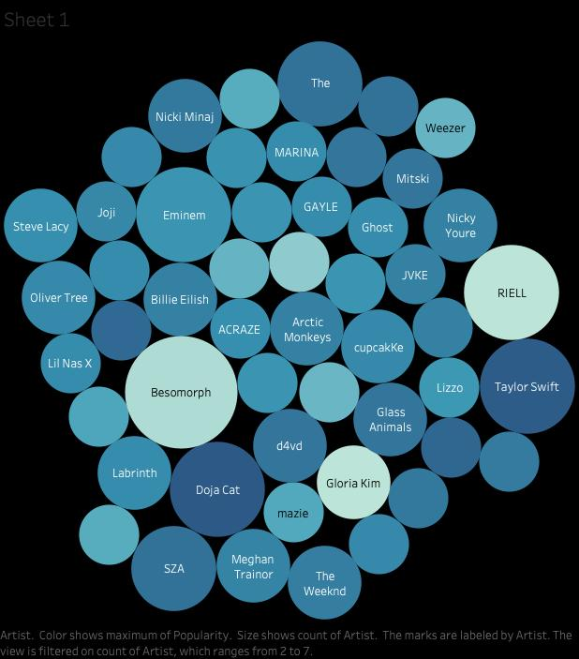
EDA
Track Name
Artist
Danceability
Energy
Valence
Key
Loudness
Speechiness
Acousticness
Instrumentalness
Liveness
Tempo
Lyrics
Notes:
Bubble plot: how many hit songs each artist has;Bigger the bubble the more hit songs own by this artist; Darker the shade the higher the average popularity

Slide 6
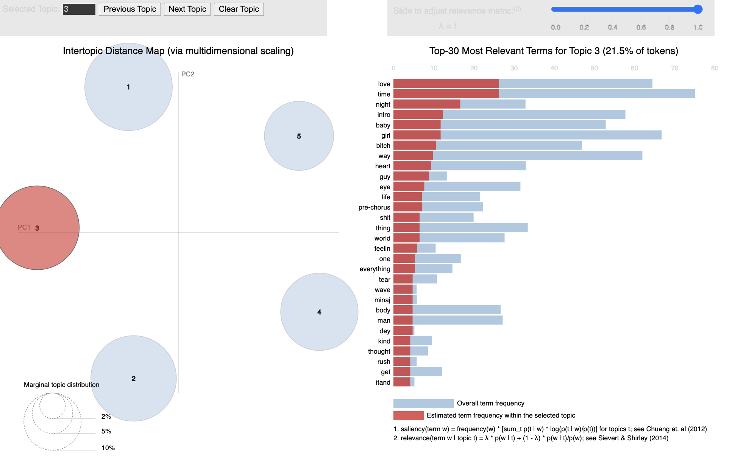
Topic Modeling
Topic1: Female Power
Topic2: Time & Nostalgia
Topic3: Love & Romance
Topic4: Friendship
Topic5: Money

Slide 7

Lift + Sentiment
'Love'
1.27 | 3.0
Notes:
We calculated lift scores and did sentiment analysis for the top 5 words in each of the 5 topics identified in the previous step. For lift, we set the popularity threshold at 82 (the median value), essentially comparing how the presence of one of the words affects a song’s likelihood to be in the top 50% of these songs (which is already a subset of the top songs). As expected, the majority of words had a neutral sentiment, leaving only two words with both a lift >1 and sentiment not equal to 0….’love’ and another word that we will not include to keep language clean but has a negative sentiment.

Slide 8
Top 5 Song Recommendations
Ranked by Likelihood to Become Popular
Super Shy by NewJeans 🌟 Score: 237.03
Good Good by USHER 🌟 Score: 236.37
TULUM by Peso Pluma 🌟 Score: 235.45
Dial Drunk (with Post Malone) by Noah Kahan 🌟 Score: 235.37
Oh U Went (feat. Drake) by Young Thug 🌟 Score: 234.96
Results
Notes:
Using both the lift scores from sentiment analysis and the numerical song attributes scrapped through the API, we were able to build a Recommendation System that provided songs that are most similar to what is popular on TikTok currently. Training our model on TikTok trends from 2022 and 2023, we applied our model to our test set of new songs in 2023. Our model checked if a song’s lyric appeared in our list of significant lift words as well as comparing the song attributes to find new songs that we argue will be popular songs to record TikToks to.

Slide 9



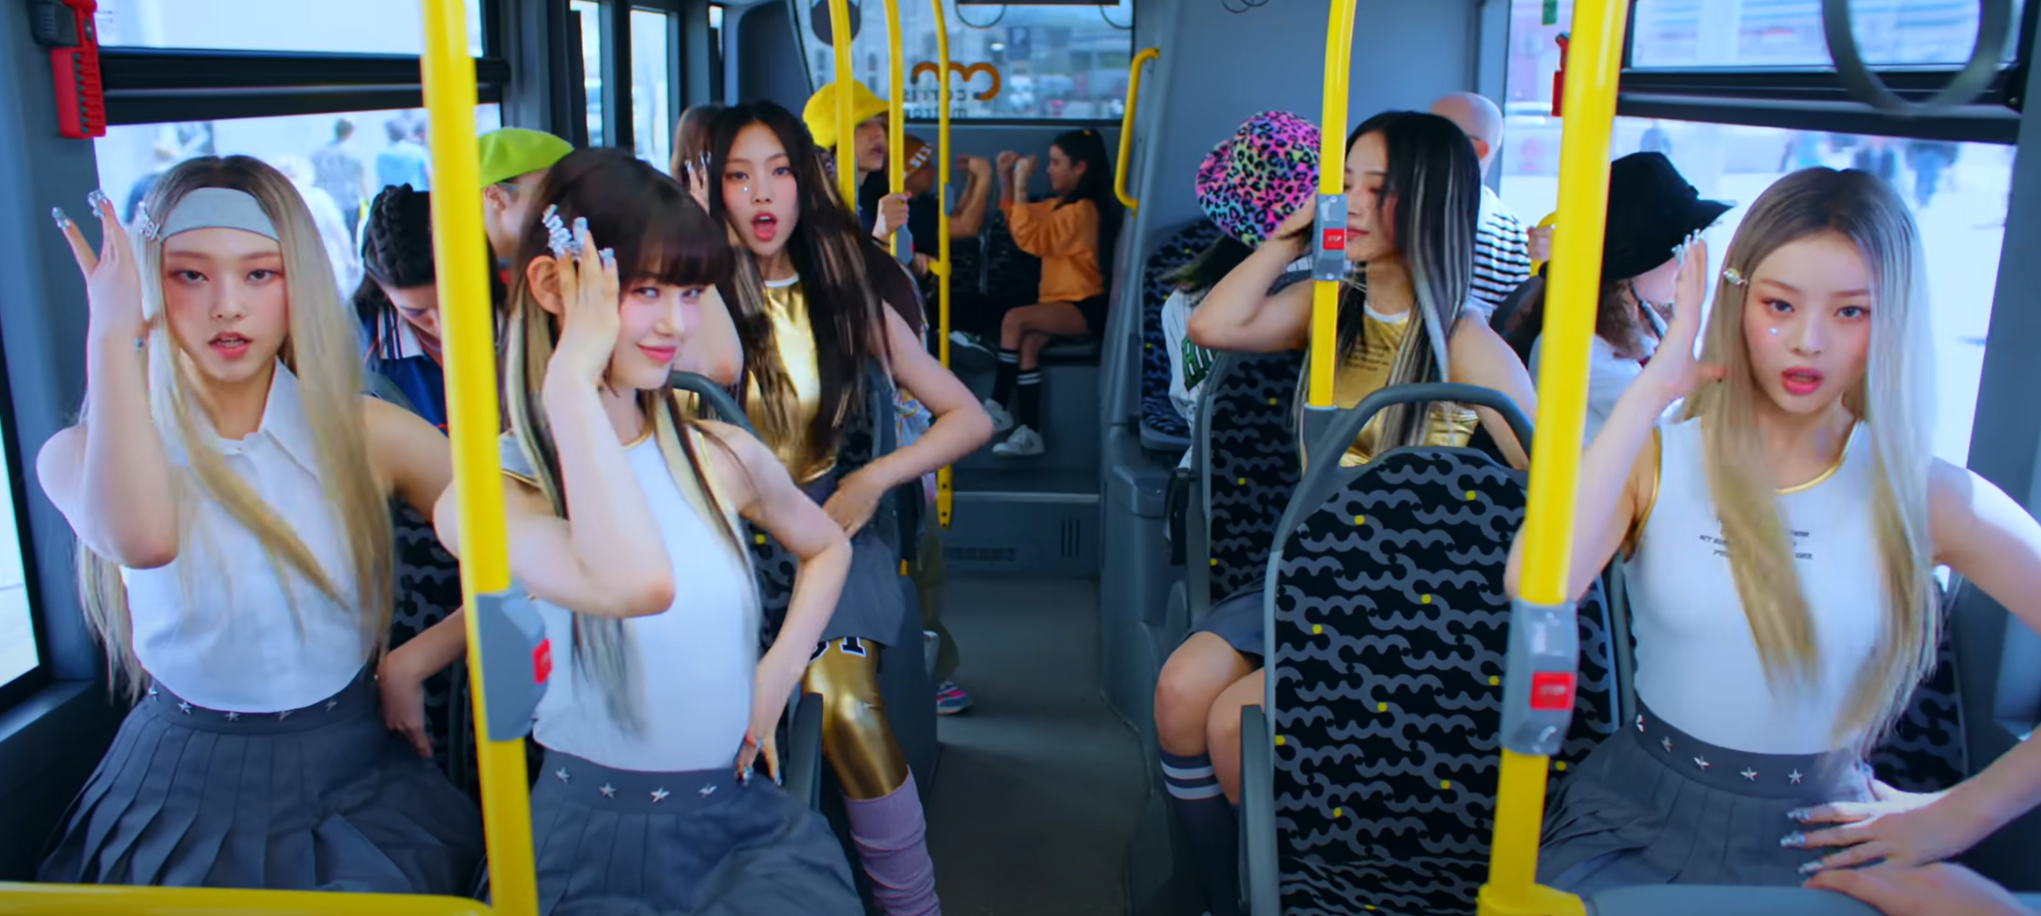

Insights & Recommendations
Notes:
In our top song recommendations, we notice a pronounced trend towards high danceability and energy levels, indicating a preference for catchy, upbeat songs. While the tempo varies, a positive valence is common, showcasing an inclination towards tracks that convey a positive, energetic vibe. These attributes, coupled with the existing popularity scores, suggest key areas of focus for identifying potential hit songs.

Slide 10
Notes:
Thank you for your time. Feel free to ask any questions you may have.

